Slide 1

Learning about evolution by building coalescent trees
Leo Speidel

Slide 2
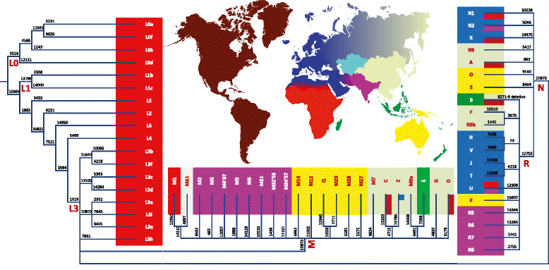
The genetic tree(s) relating humans (or any other species)
Reconstructing >100,000s years of evolution!
22 autosomal chromosomes
2 sex chromosomes
X chromosome
Y chromosome
Mitrochondrial genome
Different trees in different parts of the genome,
due to recombination
1 tree each (maternal/paternal)
Kivisild, 2015

Slide 3
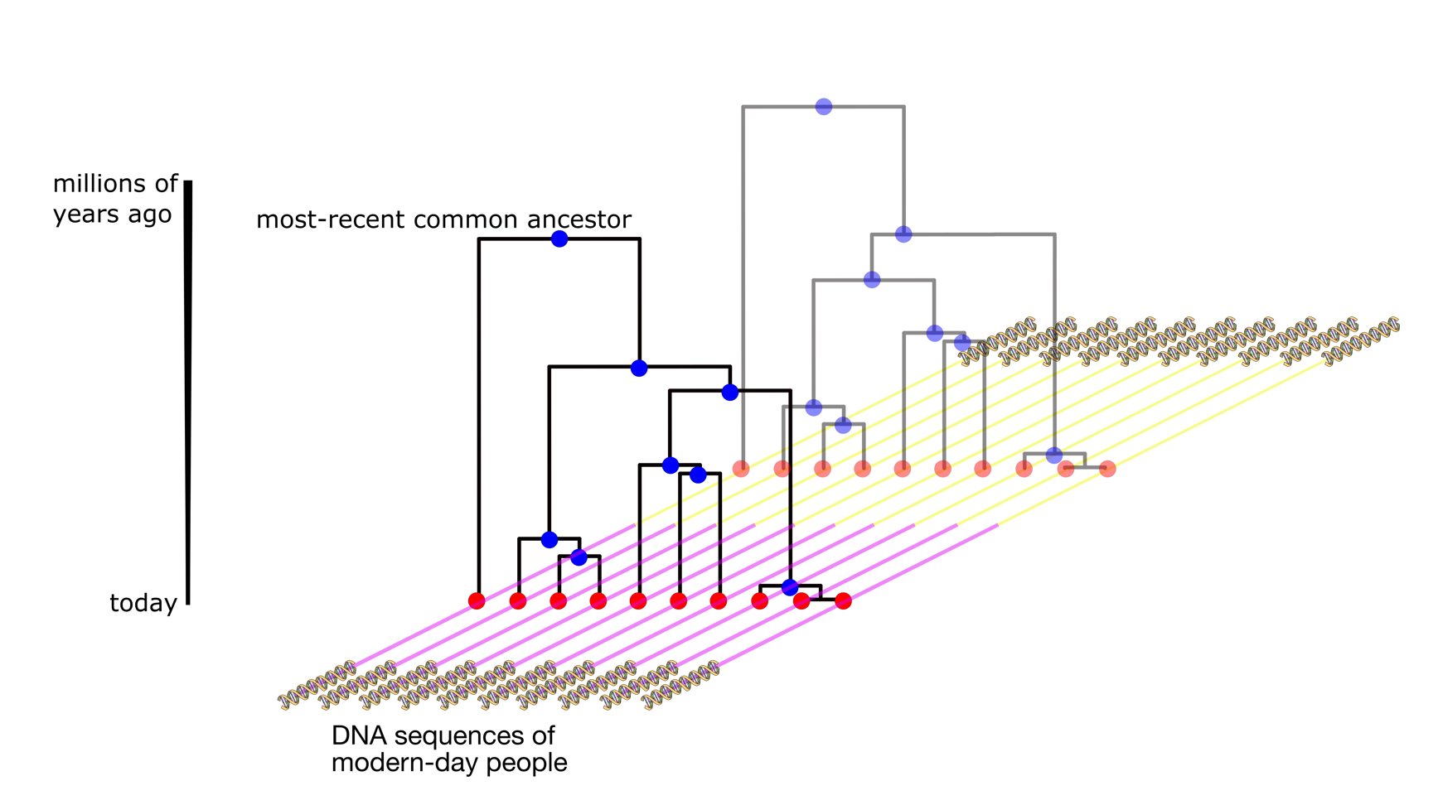
Key concept: Genealogies We are genetically related through a sequence of trees
genome
Reason for why trees change along the genome
DNA sequenced
Recombination:
mother
1 generation
from grandmother
from grandfather
offspring1
offspring2
Potentially 2M years!

Slide 4

Fundamental forces impact data (only) through underlying genealogies
polymorphic sites
individuals
Demographic history
Genetic structure
Admixture
Selection, etc.

Slide 5
Many canonical approaches
polymorphic sites
individuals
Demographic history
Genetic structure
Admixture
Selection, etc.
Invent informative statistics, simplify, "integrate out all possible histories”
Allele frequency-based methods
Local haplotype sharing
Mutation sharing (e.g., f statistics)

Slide 6
Genealogies are the “unobserved link” between evolutionary processes and genetic variation
polymorphic sites
individuals
Invent informative statistics, simplify, "integrate out all possible histories”
Allele frequency-based methods
Local haplotype sharing
Mutation sharing (e.g., f statistics)
Demographic history
Genetic structure
Admixture
Selection, etc.
Challenges: computationally very challenging to sample trees from the data, and modern datasets can contain >50,000 individuals and >100,000,000 mutations

Slide 7
We can now build these trees for many thousands of individuals and add a time dimension onto our genetic data
Old problem, lots of methods, but few can scale:
ARGweaver
Rent+
Tsinfer + tsdate
ARG-Needle
Relate
Infers Ancestral Recombination Graphs
Published in since 2019,
scale to large sample sizes
We will talk about Relate, but principles of
tree-based inference applies more generally!

Slide 8
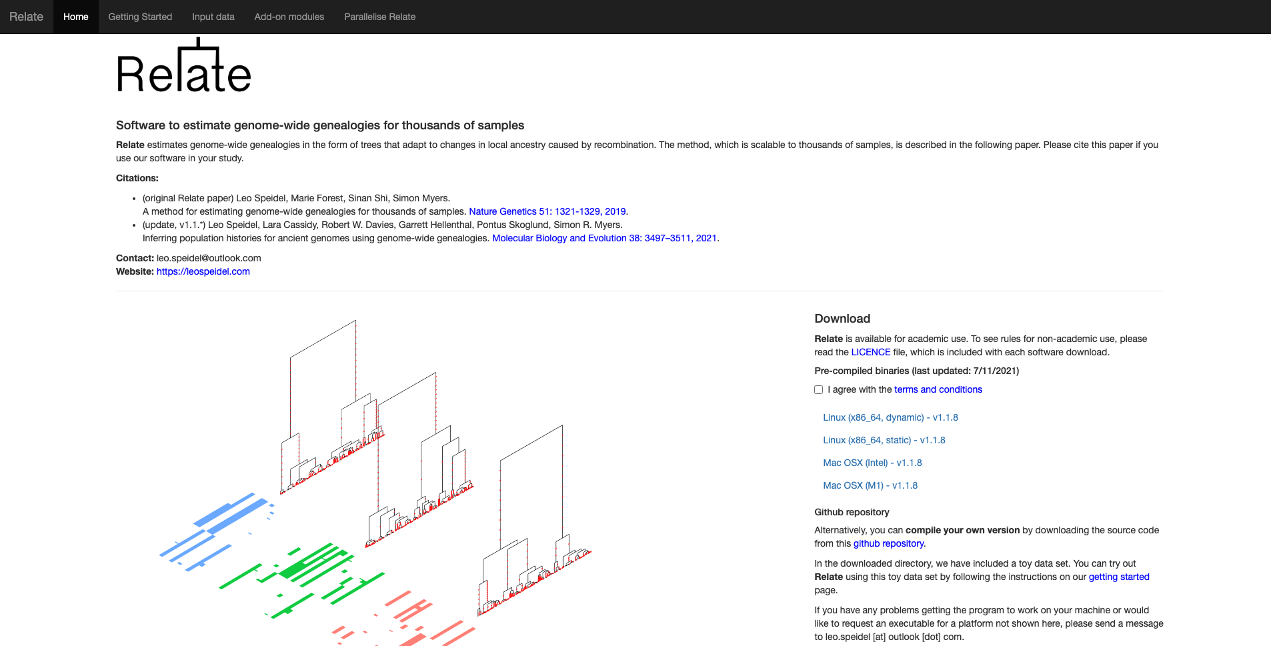
Relate
Speidel, Forest, Shi, Myers. Nature Genetics 2019
Speidel, Cassidy, Davies, Hellenthal, Skoglund, Myers, MBE, 2021
https://myersgroup.github.io/relate/
Key features:
Fast & accurate
Robust to errors!
Jointly infers branch lengths and demographic history
Moderns and ancients
Lots of add-on tools for various types of analyses

Slide 9
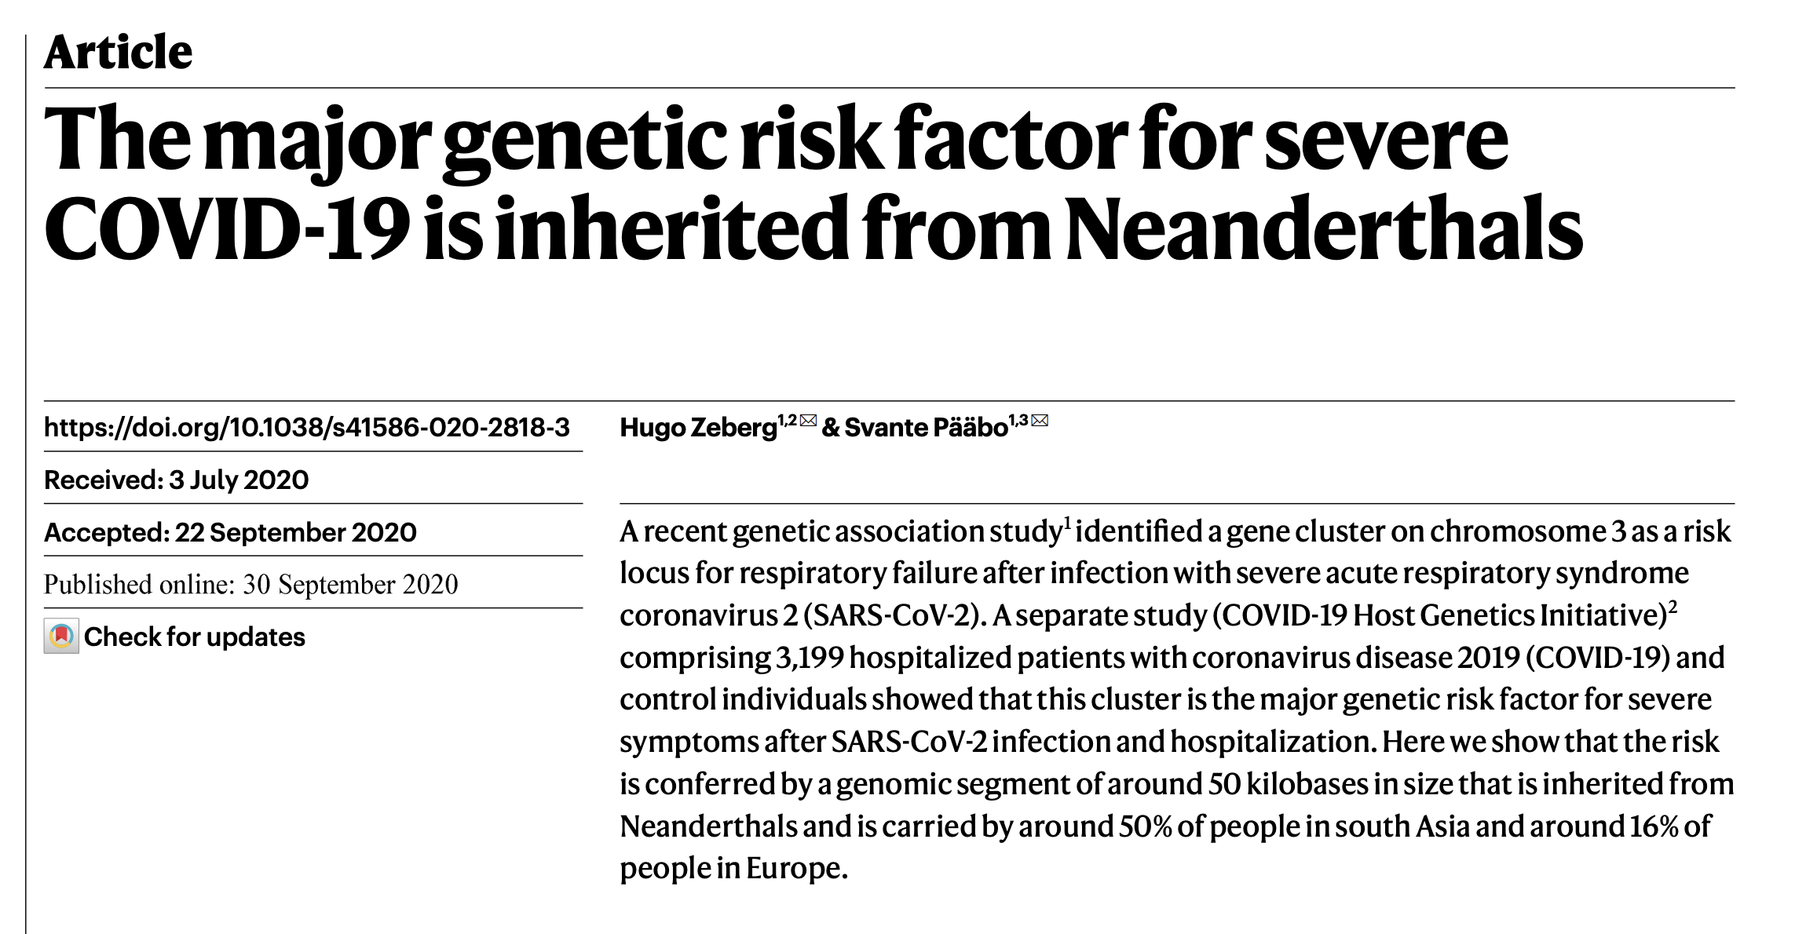
One locus can already tell us a lot about our history
Neanderthal
Denisova
~60k years ago
Notes:
Swap tree plot

Slide 10
Positive selection: rapidly spreading lineage
Lactose tolerance
as adults (rs4988235)

Slide 11
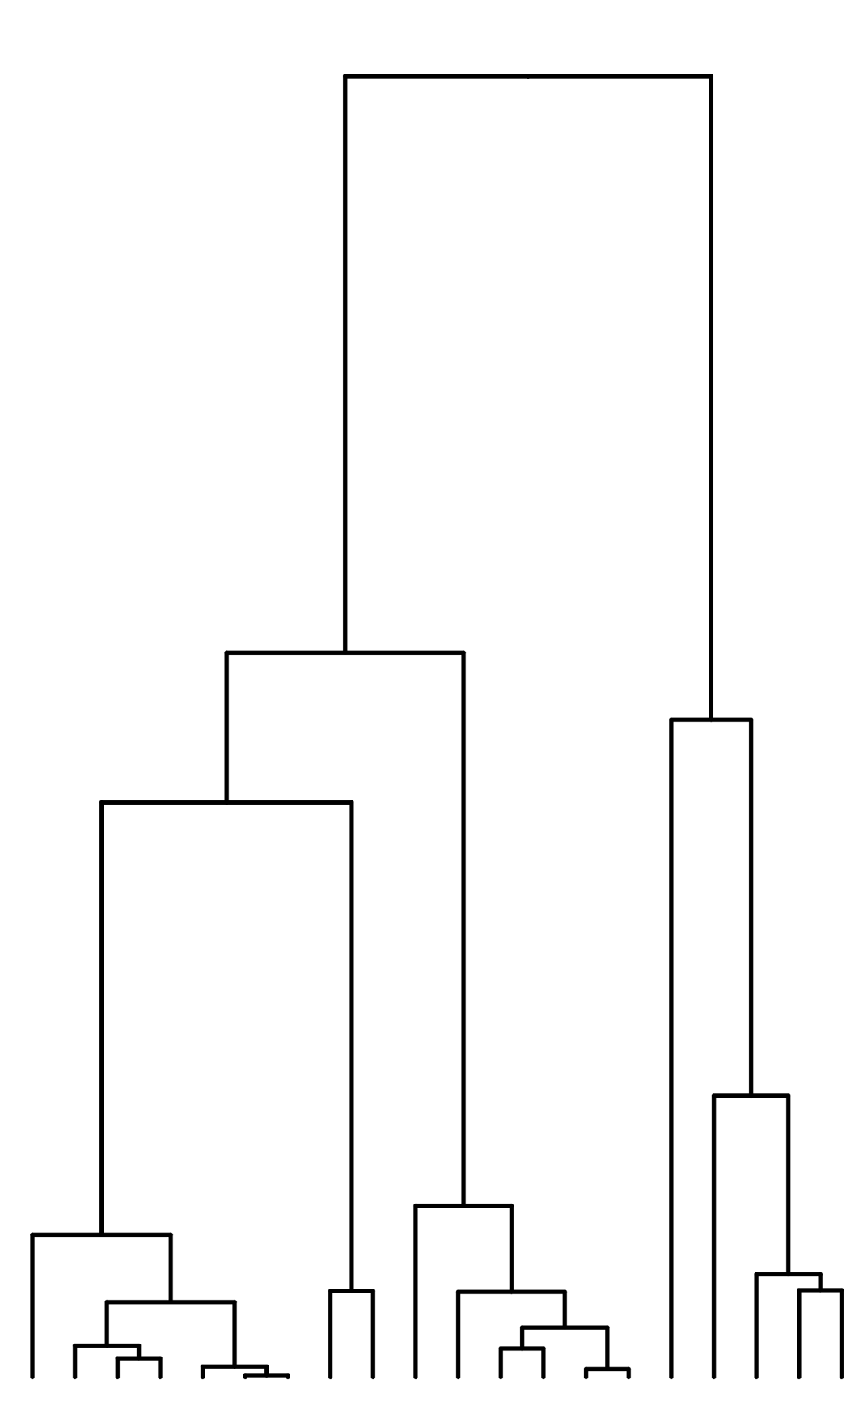
Clusters of mutations in time can capture changes in mutation rate
Mutation rate
time

Slide 12
Inferring genealogies from genetic variation

Slide 13
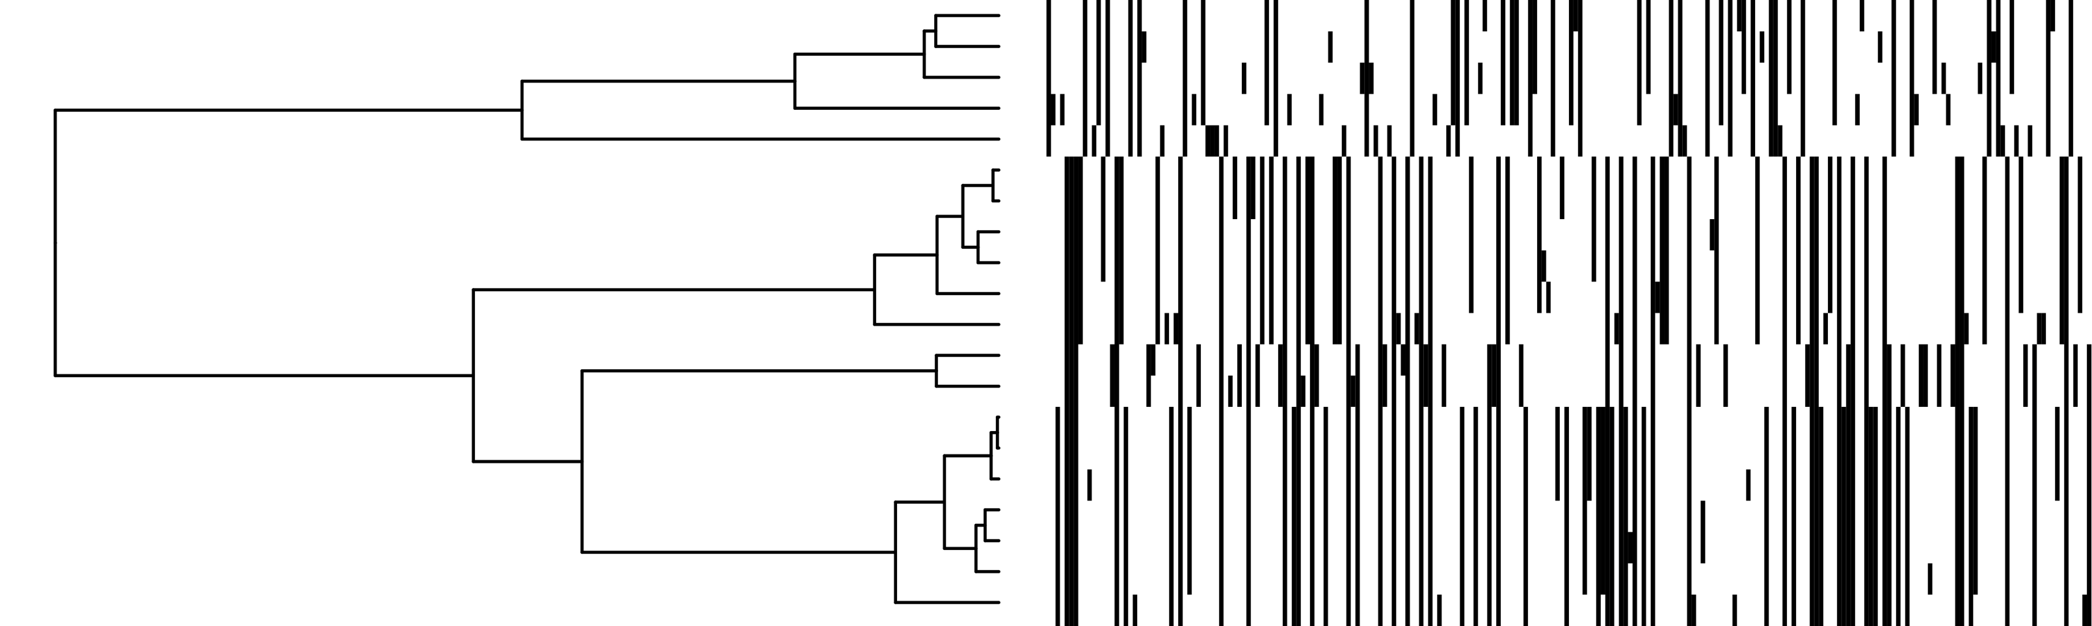
Data and the underlying tree structure
polymorphisms
individuals
Every mutation shows the existence of a branch
Mutations are “ordered by inclusion”
No two branches (mutations) ever show only partial overlap

Slide 14
Count derived mutations to reconstruct tree topology
For tree topology, we want to quantify the order in which we are related to others
Count number of “derived mutations” to get order of coalescences
E.g., sequence a has 1 derived mutation to (b,c)
2 derived mutation to (d,e,f)
Coalesce mutually closest lineages
No recombination: Guaranteed to build tree consistent with data
This is not the case if we use “pairwise differences” (UPGMA)
a and (d,e,f) are closer than a and (b,c)
Use chromosome painting to count derived mutations accounting for recombination
a
b
c
d
e
f

Slide 15
Summary of Relate
“number of derived mutations”

Slide 16
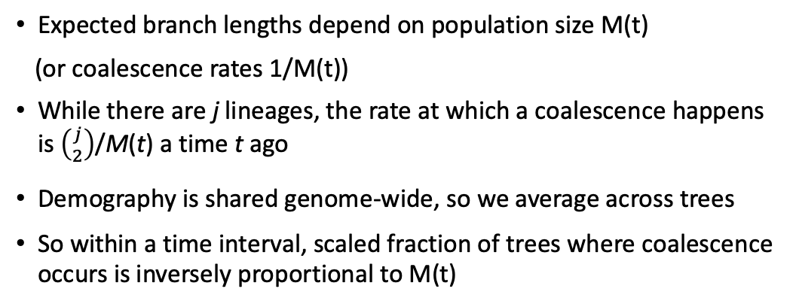
Branch lengths and population size is estimated jointly in an EM algorithm
M(t)
Expected branch lengths depend on population size M(t)
(or coalescence rates 1/M(t))
While there are j lineages, the rate at which a coalescence happens is $\left({j \atop 2}\right)$/M(t) a time t ago
Demography is shared genome-wide, so we average across trees
So within a time interval, scaled fraction of trees where coalescence occurs is inversely proportional to M(t)
Li-and Stephens copying model
Build Relate trees
EM algorithm
Infer branch lengths
using constant M(t)
Infer M(t) from tree
Infer branch lengths
using constant M(t)
Using the coalescent
Using the coalescent
Using the coalescent

Slide 17
Population size changes through time are jointly inferred in Relate
- Effective population size = inverse coalescence rate
- N: number of diploid samples

Slide 18
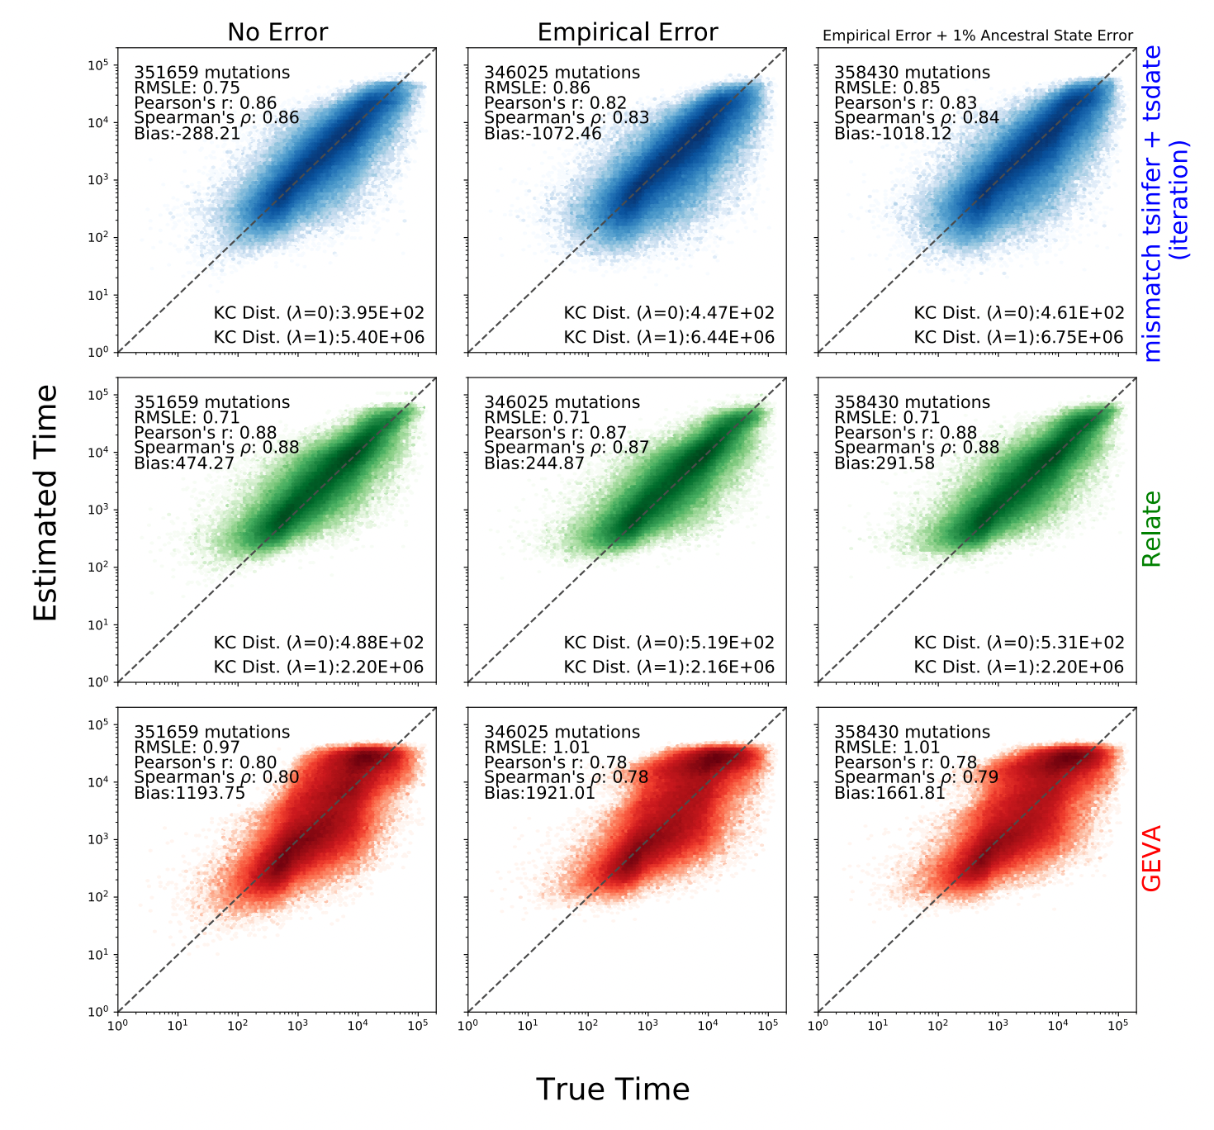
Speed and accuracy of Relate
About 14,000 times faster than previous method, ARGWEAVER (1 min. vs. 200 hours), slower than tsinfer + tsdate
Builds “correct” tree if no recombination
Accurate, robust to data errors
Can sample posterior branch lengths
Wohns et al. Science 2022
Notes:
Use tsdate plots?

Slide 19
Genealogy-based inference of human evolutionary history
One reconstruction of history, many applications that are self consistent

Slide 20
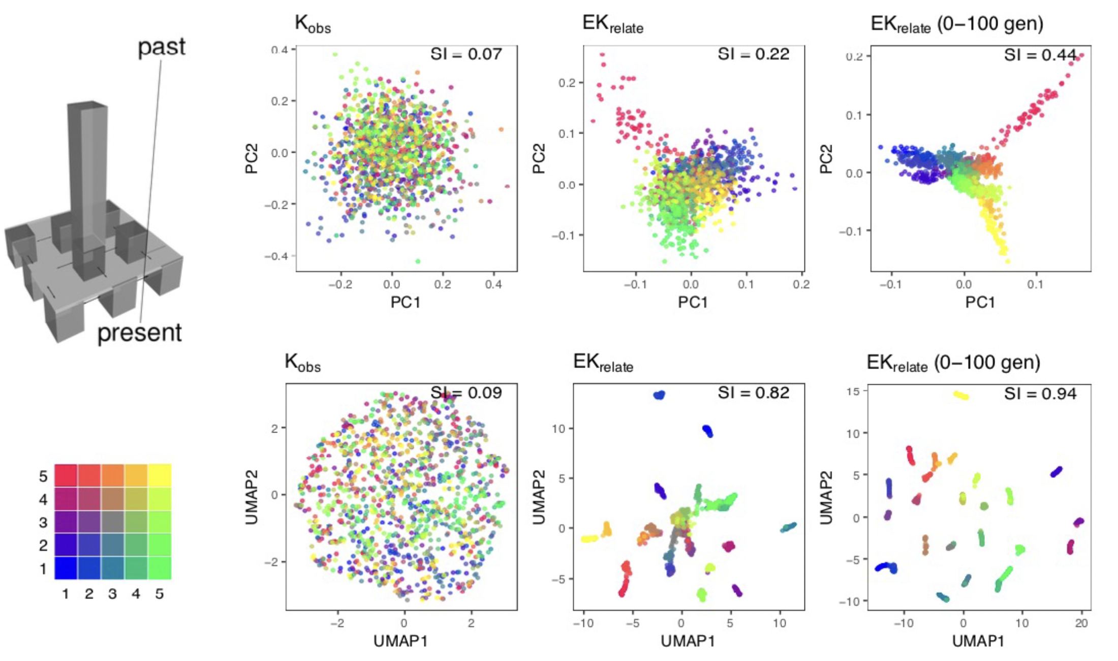
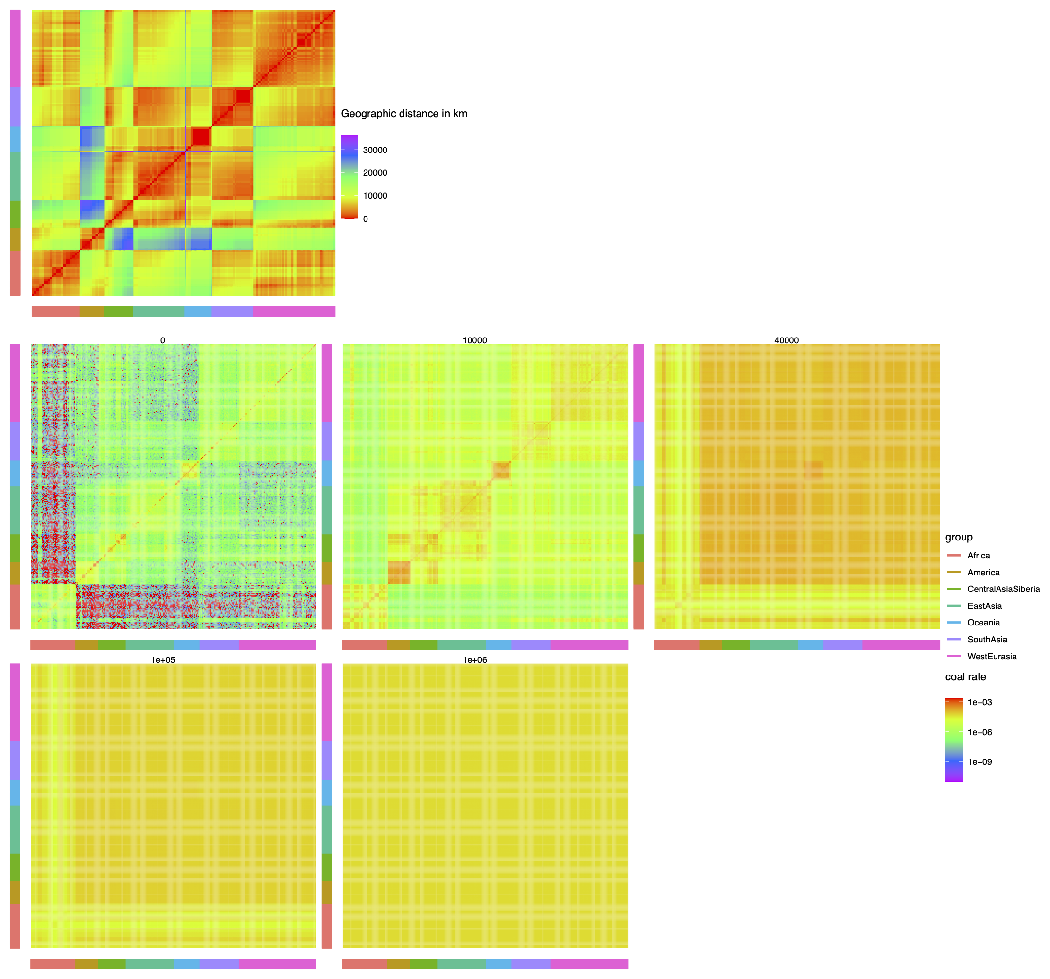
Inferring fine-scale population structure and how it changed through time
Fan, Mancuso, Chiang, bioRxiv, 2021
Genotype matrix
Relate trees
Relate trees (0-100gen)
Speidel et al, MBE, 2021
Simons Genome Diversity Project
0-1000 years
10,000 years
40,000 years
100,000 years
1,000,000 years
Coalescence rates

Slide 21
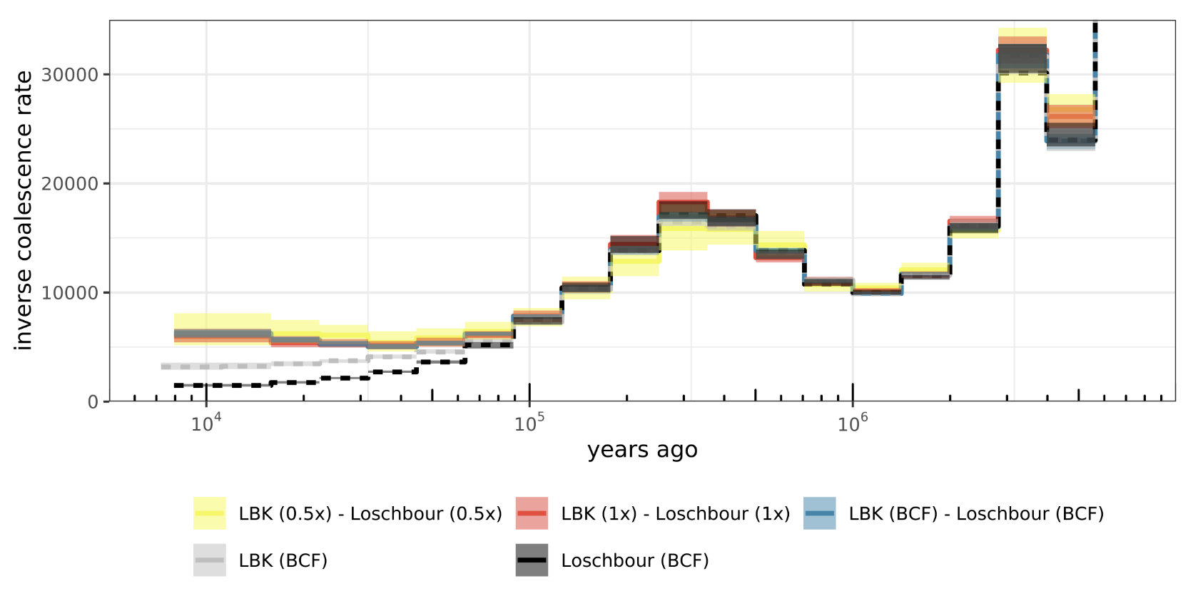
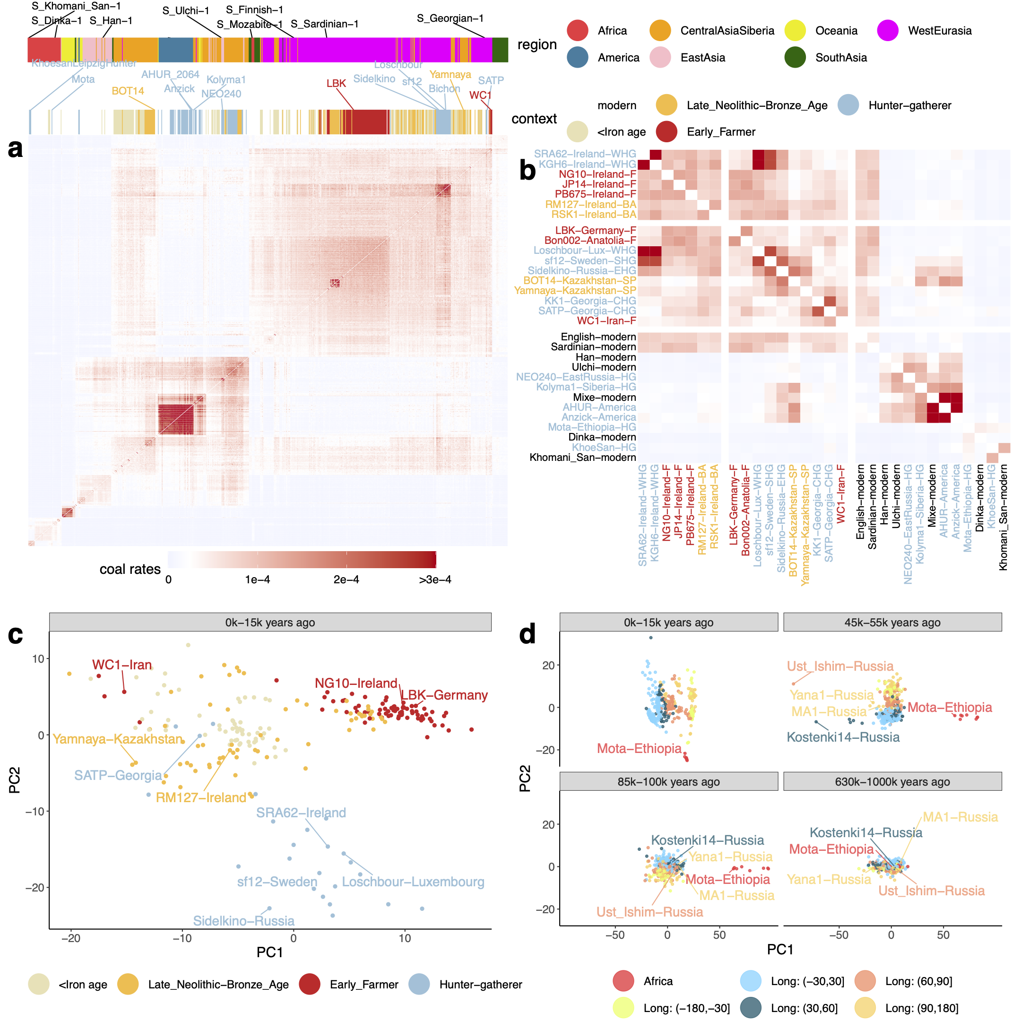
Colate: Inferring coalescence rates for low-coverage, unphased (ancient) genomes
Eastern HG
Speidel et al. MBE, 2021
Yamnaya/Steppe
expansion
Steppe Pastoralists
Caucasus HG
PCA
Yamnaya/Steppe
expansion
Western hunter-gatherers
Steppe
Pastoralists
Introduction of
Farming
(>5000 years ago)
Anatolia

Slide 22
Clusters of mutations in time can capture changes in mutation rate
Mutation rate
time

Slide 23
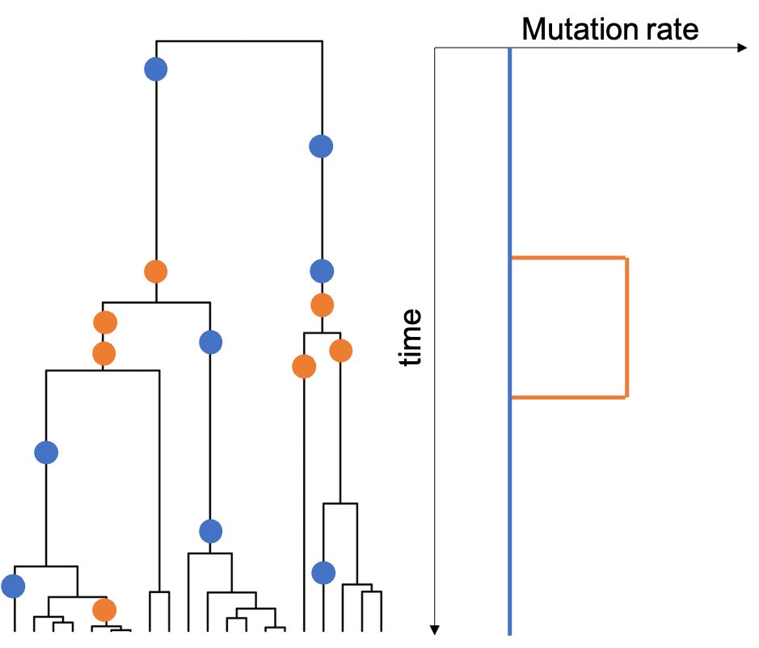
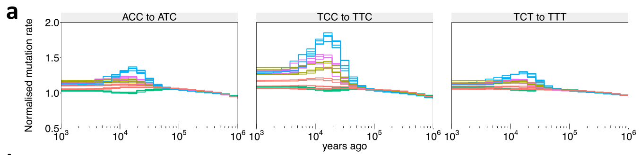
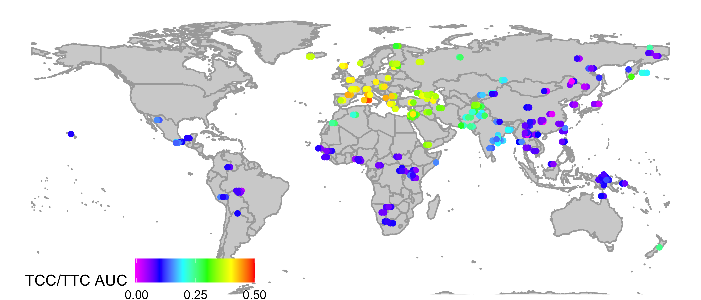
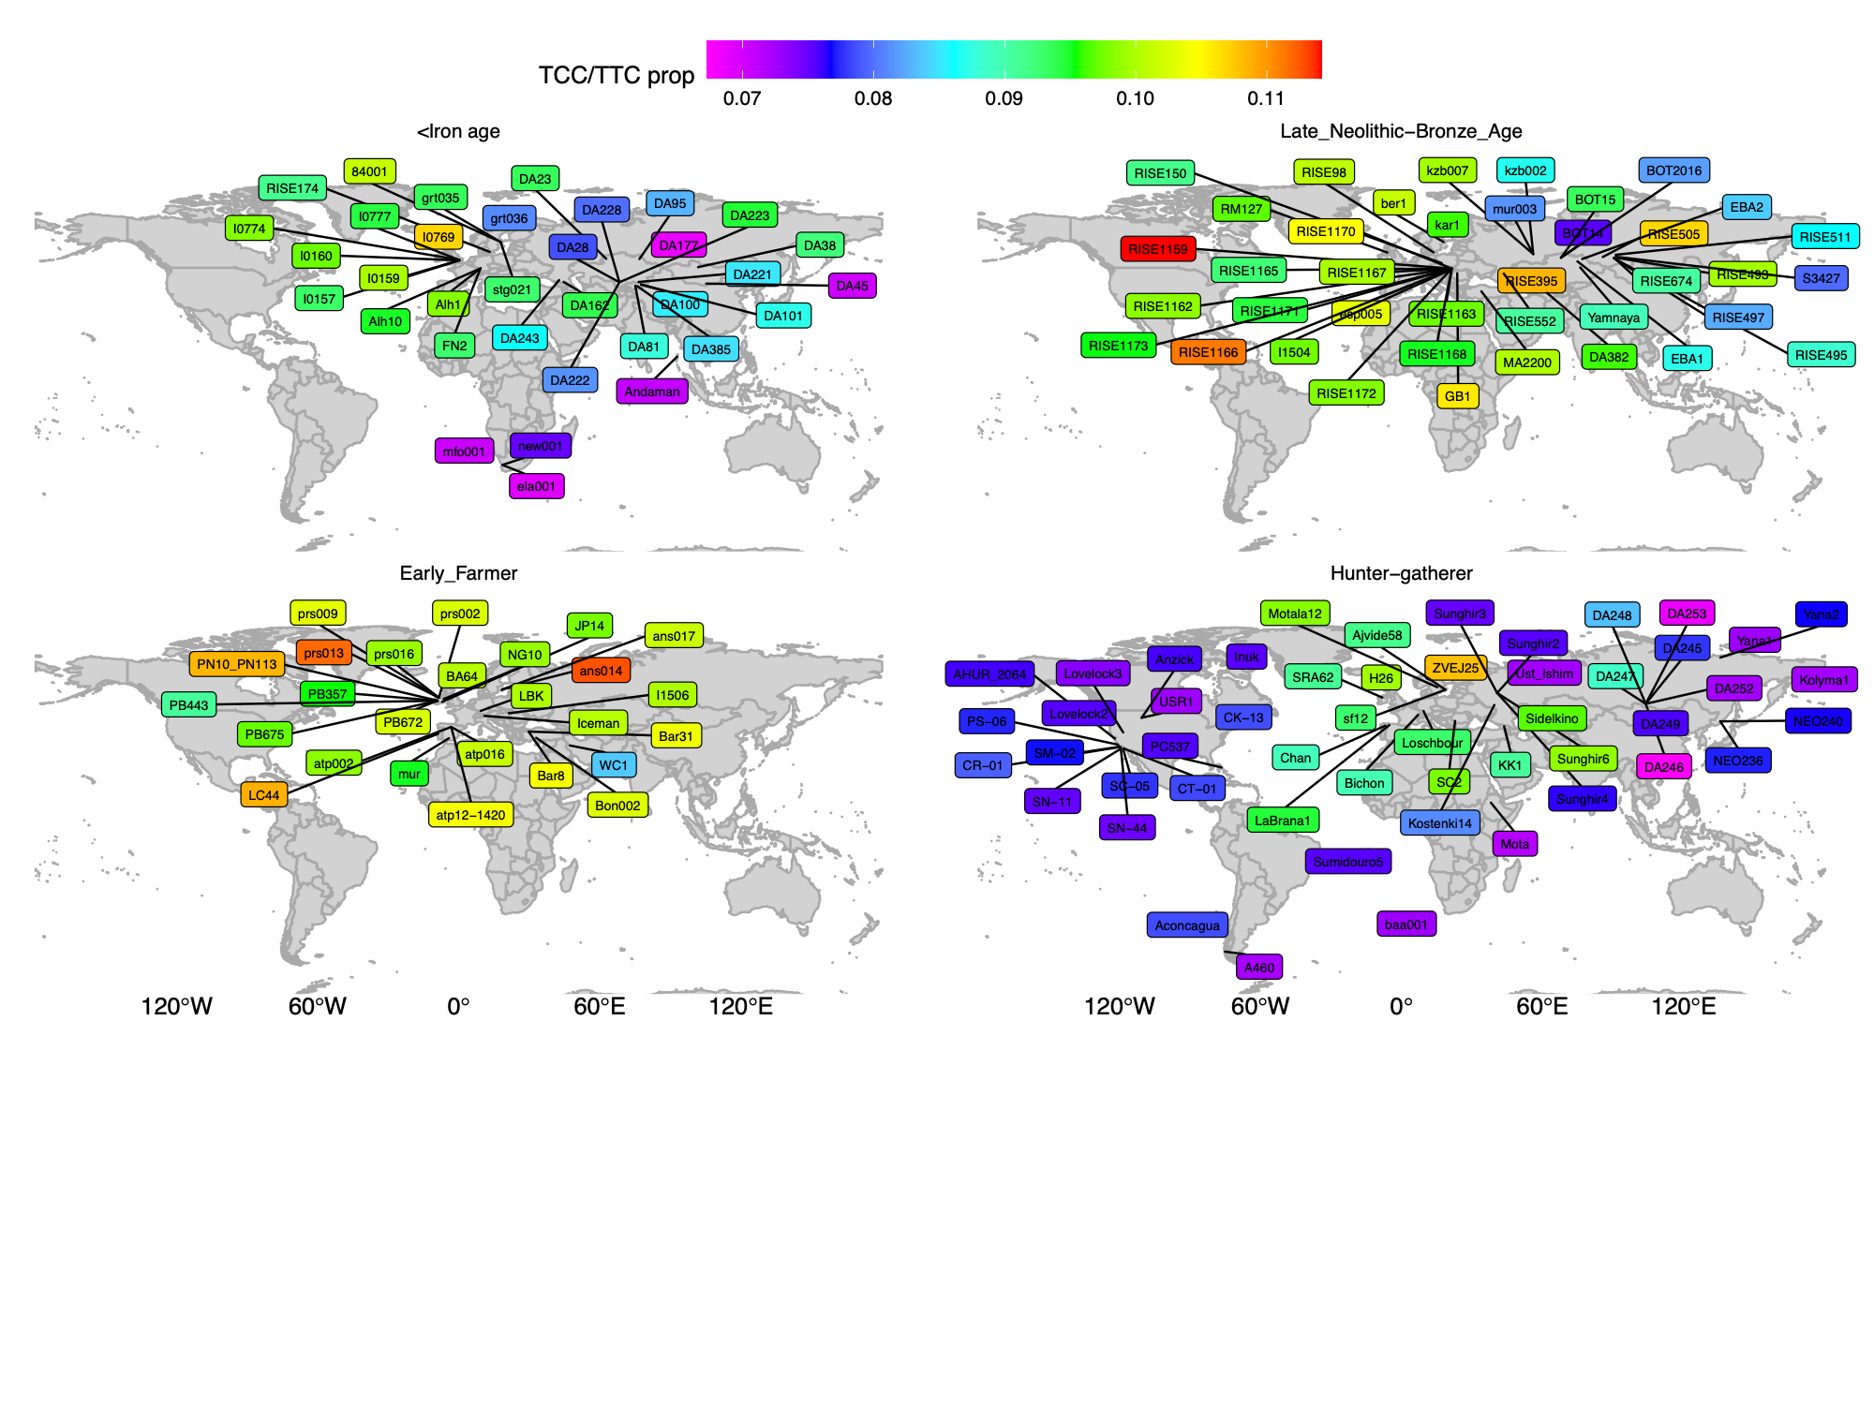
TCC/TTC mutation rates have experienced a strong pulse in the Upper Paleolithic
First reported by Kelley Harris (PNAS 2015, eLife 2017)
Unknown cause (genetic?, environmental?)
Previously mainly studied in modern groups
Normalised mutation rate
Speidel, Nature Genetics, 2019
How did this spread to all West Eurasians today?
Colour shows strength of elevation
in TCC/TTC mutation rates

Slide 24
TCC/TTC mutation rate increase happened and spread before farming, >15k years ago!
Speidel et al, MBE, 2021
Ice Age Europe
>20,000 years ago
❄️ ICE ❄️
e.g., Sunghir3 (30k year old)
earlier HG groups
e.g., Sidelkino (11k year old)
Eastern HG
e.g., Bichon (14k year old)
Western HG
Caucasus HG
e.g., KK1 (9k year old)
Anatolia
e.g., Bon002 (10k year old)
Colour shows strength of elevation in TCC/TTC mutation rates

Slide 25
Quantifying positive natural selection on a single mutation
Genetic adaptations to changing environment, diet, lifestyles,…
Use trees incorporating demographic history

Slide 26
How quickly does a mutation spread in the neutral case?
k = 2
Z₁=5
Z₂=2
n=7
We can write down the analytical distribution for the
number of descendants of a mutation arising while k lineages remain
Example: if k=2, this is just a uniform distribution
P(5 descendants)=1/6

Slide 27
The k = 2 case
We expect “unbalanced” tree shapes!
3
5
9
7
5
1
6
8
5
4
5
2
4
4
7
6
6
3

Slide 28
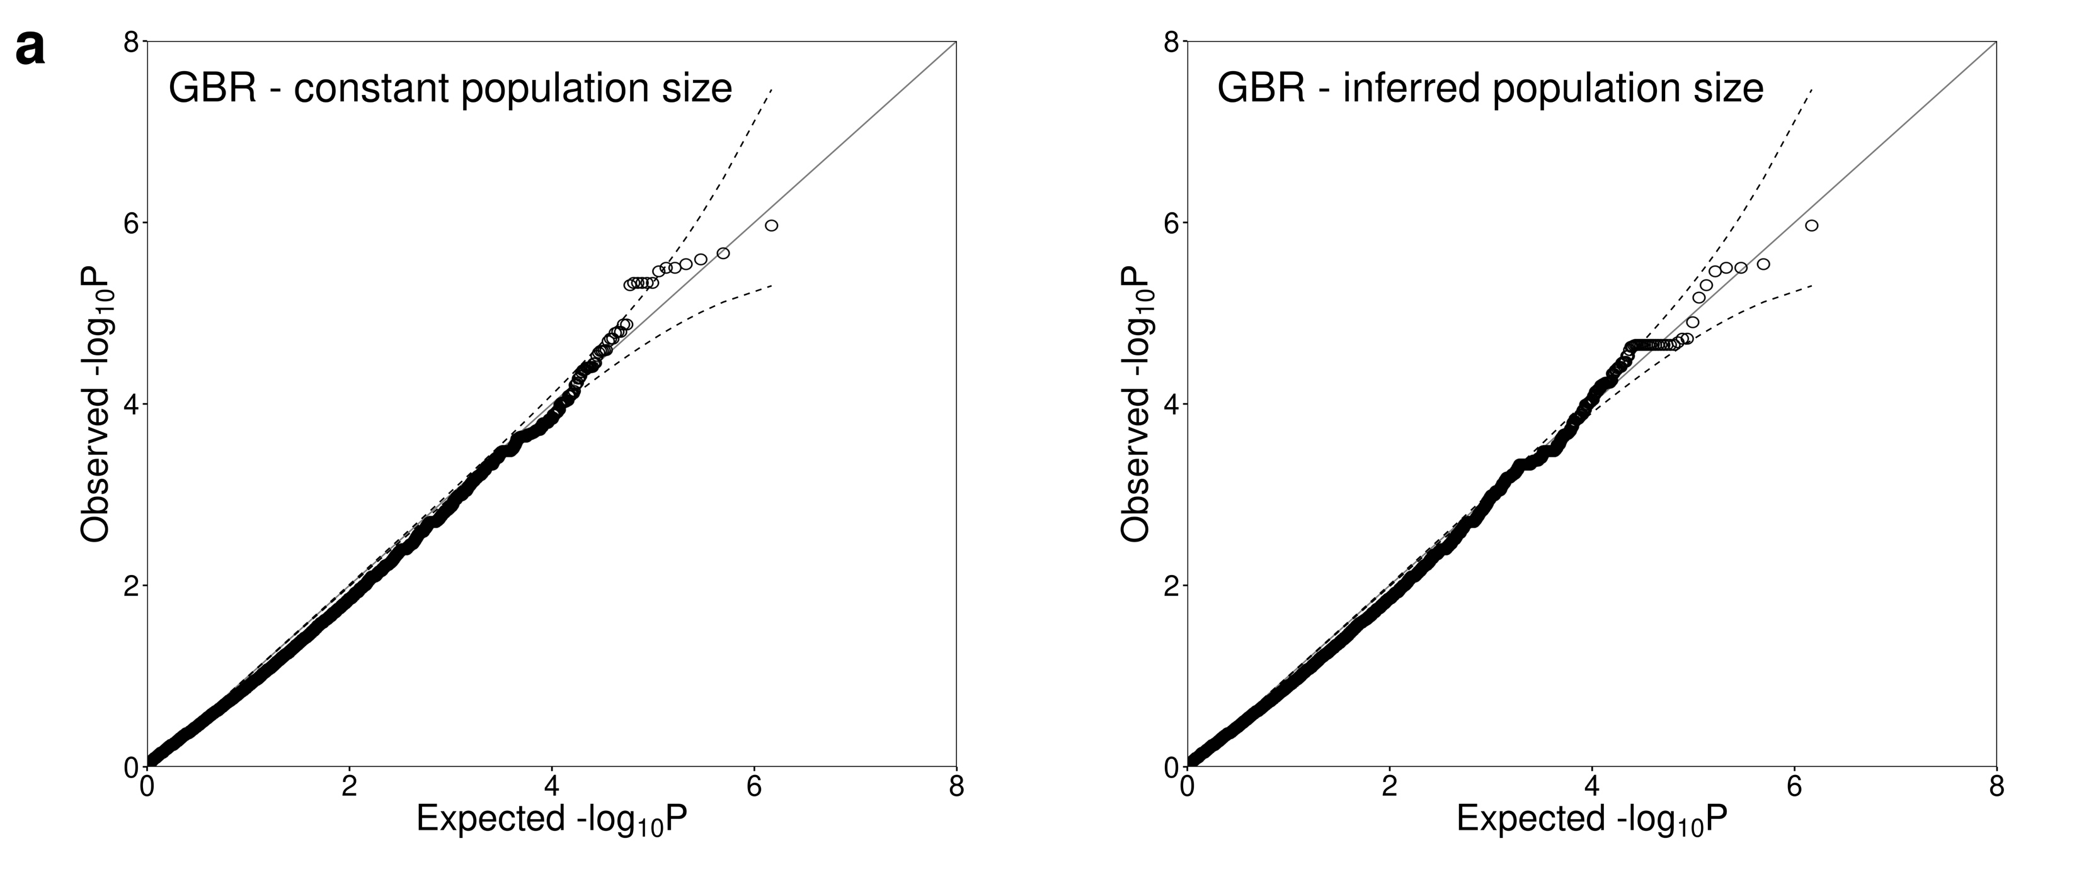
P-values: very well calibrated under null simulations of no selection
N=1000, 250Mb
Bottleneck population size
Quantile-quantile plot:
Incorrect constant population size
Inferred varying population size

Slide 29
Improved power to see weak selection

Slide 30
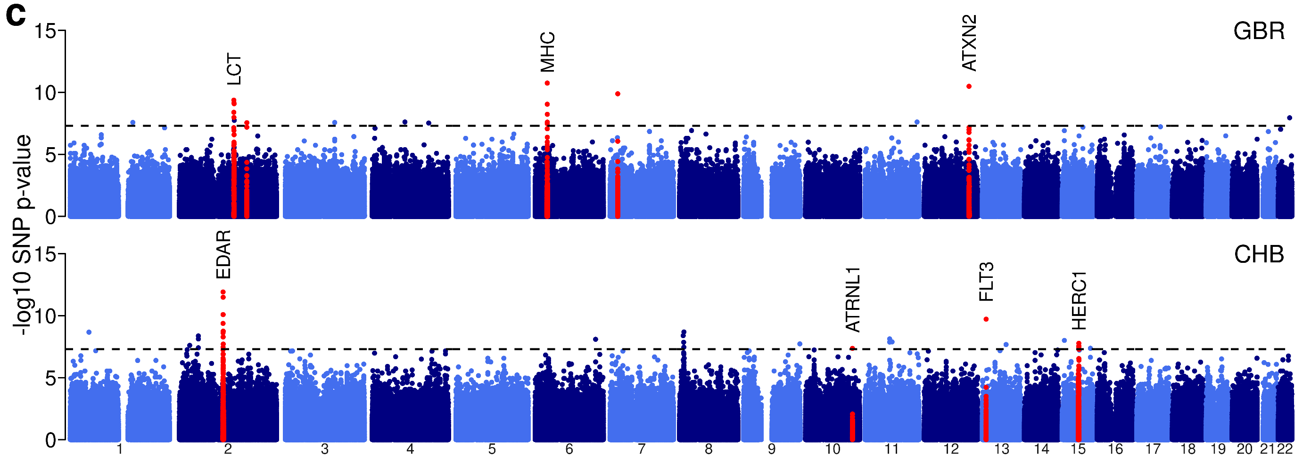
Genome-wide selection p-values
Given most traits are highly polygenic, expect mainly weak, polygenic selection
How does weak selection evidence vary by trait?

Slide 31
Many key events in our evolutionary history are only implicated as subtle effects in our genomes
Selection p-values: only a handful of “genome-wide significant” loci
log10 p-value
Lots of Polygenic selection signals
Weak selection on individual mutations
is hard to detect,
compared to shifts in distributions
Nominal significance
(p=0.05)
(no selection)
(weak selection)
(strong selection)

Slide 32
Evidence of selection on a trait: hair colour
Use effect direction of ”genome-wide significant” associations
Compare selection p-values to frequency matched random SNPs (Wilcoxon rank-sum test)
Relate p-values
iHS scores

Slide 33

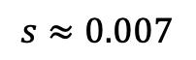
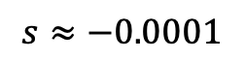
CLUES: Importance-sampling based method for inferring selection coefficients
Aaron Stern
Aaron J. Stern, Peter R. Wilton, Rasmus Nielsen. PLOS Genetics, 2019.
Aaron J. Stern, Leo Speidel, Noah A. Zaitlen, Rasmus Nielsen. AJHG 2021
Simulations:
1000 Genomes Project British:
$$s≈−0.0001$$
$$s≈0.007$$

Slide 34



Summary & outlook
It is now possible to build genealogical trees for huge datasets, in humans and other species (currently 10,000 individuals or more)
Humans (ancient and present)
Dogs and wolves
Mice
Bacteria
Atlantic cod, Cichlids
Waterhemp, Arabidopsis
These trees capture information about many processes including
Migrations and ancient introgression
Mutation rate evolution
Trait evolution
(and many more things)
Lots of scope for more methods using inferred genealogies under development
….creative approaches to leverage trees to answer biological questions!

